Slide 1



Introduction to Sentimental Analysis in Stock Market Analysis
Sentimental analysis, also known as opinion mining, is an approach used in stock market analysis to determine, quantify, and interpret the overall sentiment of investors regarding a particular asset or security. It involves analyzing data from sources such as news articles, social media, and financial reports to gauge market sentiment.
by Mohit Soni

Slide 2
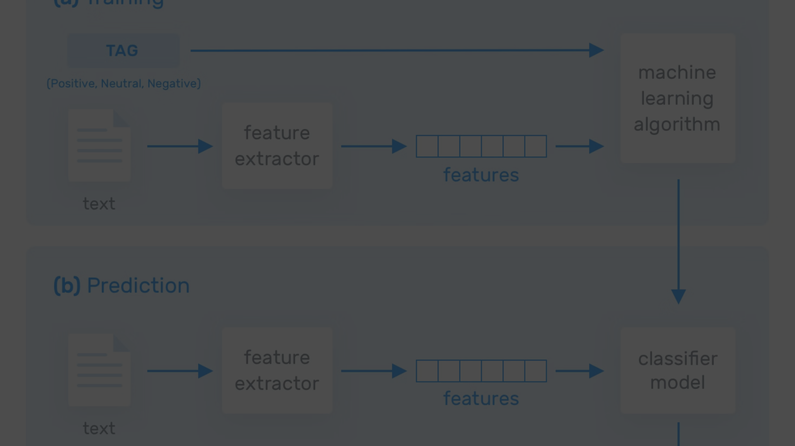
How Sentimental Analysis Works
1
Data Collection
2
Sentiment Classification
3
Insight Generation
Various types of data are gathered from multiple sources, including social media, news outlets, and financial reports.
The data is then processed using natural language processing and machine learning techniques to classify the sentiment as positive, negative, or neutral.
The final step involves generating actionable insights based on the sentiment analysis to guide investment decisions.

Slide 3
Benefits of Using Sentimental Analysis in Stock Market Analysis
Market Signals
Enhanced Decision Making
Risk Mitigation
Provides early indicators of potential market movements based on crowd sentiment.
Assists in making informed and strategic investment decisions.
Identifies and mitigates risks associated with market sentiment fluctuations.
Augments traditional financial analysis with sentiment-derived insights.
Helps in understanding investor emotions and behavior.
Improves risk management strategies.

Slide 4




Challenges and Limitations of Sentimental Analysis in Stock Market Analysis
Data Noise
Human Bias
Volatility Impact
Challenges in filtering noise and irrelevant data from social media and news.
Risk of human sentiment bias impacting the accuracy of the analysis.
Difficulty in dealing with sentiment-driven market volatility and rapid sentiment shifts.

Slide 5
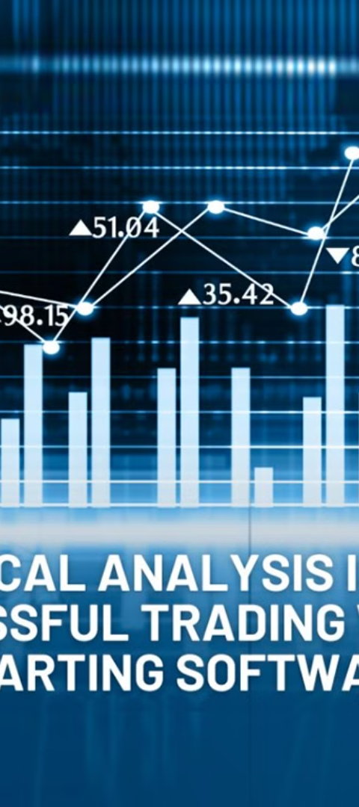
Case Studies and Examples of Successful Sentimental Analysis in Stock Market Analysis
1
Tesla Stock Surge
Successful prediction of Tesla's stock gains based on positive investor sentiment.
2
COVID-19 Impact Analysis
Utilization of sentiment analysis during the COVID-19 pandemic for forecasting market reactions.
3
Product Launch Reception
Examination of how positive public sentiment can affect new product launches and stock values.

Slide 6
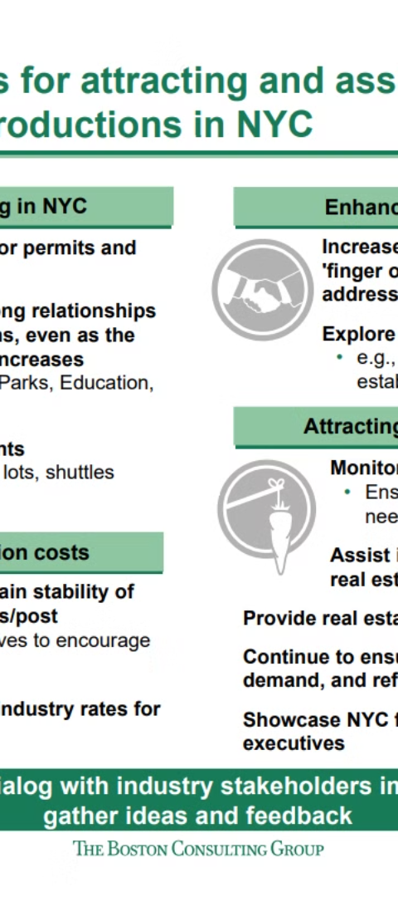
Conclusion and Key Takeaways
Insights from Data
Integrated Strategy
Key takeaways from sentiment analysis provide valuable insights for market trends.
Emphasizes the importance of integrating sentiment analysis with traditional analytics for holistic investment strategies.
Evolving Landscape
Summary of the evolution in stock market analysis methodologies with the integration of sentimental analysis.

